Slide 1
Towards happier, healthier lives
Bessie Bulman, Project Officer
Sumaty Hernandez-Farina, Project Officer
Nadia Holland, Project Officer
3 July, 2023

Slide 2
What is Thrive LDN?
Who we are
Thrive LDN is a citywide public mental health partnership to ensure all Londoners have an equal opportunity for good mental health and wellbeing.
Launched publicly by the Mayor of London and the London Health Board partners in 2017.
Thrive LDN provides an overarching brand for a coalition of partners working towards the shared mission of ensuring everyone living or working in London is treated fairly and can live a happy and healthy life.
Guiding principles
Equity
Proportionate universalism and intersectionality underpin all action.
Participation
Channel participatory energy through a balance of bottom-up and top-down approaches.
Wider determinants of health
Prioritise activities that impact the wider determinants for mental health and wellbeing.
Complex systems
Drive outcomes across three broad levels – individuals, communities and systems - improve Londoners’ mental health and wellbeing.

Slide 3
Early years, children and young people’s mental health & wellbeing

Slide 4
What do we know?
Parents and early years
70% of new parents feel stressed and judged by other parents.
With 4 in 10 single parents feel anxious, to the extent it interferes with their day to day life.
Achieving a healthy start for babies 0-5 is strongly linked to better outcomes later in life
A 1/3 of all poor adult mental health can be attributed to experiencing multiple adversity in childhood

Slide 5
What do we know?
Children and young people
Since the pandemic, 1 in 6 young people experience a mental disorder
Over 10,000 new referrals are made each month on average to CYP service in London
Young people express that those in position of authority including schools are working against their interests
Current events, contribute to ‘cycles of insecurity’ which affect young Londoners who feel a lack of agency and impact on decisions which affect them

Slide 6
National CYP priorities
NHS Long Term Plan commitments
Access: By 2023/24, at least an additional 345,000 children and young people aged 0-25 will be able to access NHS-funded mental health services.
Crisis Services: With a single point of access through NHS 111, all children and young people experiencing crisis will be able to access crisis care 24/7 by 2023/24.
Digital Therapies: Develop digitally enabled care pathways for children and young people in ways which increase inclusion.
Eating Disorders: investment in CYP eating disorder services to continue seeing 95% of urgent cases within 1 week, and within 4 weeks for non-urgent cases.
Equality: support local health systems to better address inequalities in access, experience and outcomes. Advancing Mental Health Equalities Action Plan includes CYP mental health specific actions.
Four Week Waiting Times: Test approaches that could deliver 4ww times for access to NHS support, ahead of introducing new national waiting time standards for all children and young people who need specialist MH services.
Mental Health Support Teams (MHSTs): MHSTs working in schools and colleges – early intervention and whole school approach across 20-25% of country by 2023
Wider Commitments: Additional investment in Youth Justice services; Reduced waiting times and increased support for children and young people with learning disabilities and/ or autism; 6,000 highly vulnerable children with complex trauma will receive consultation, advice, assessment, treatment and transition into integrated services.
Whole pathways, including inpatient beds: Extension of New Models of Care/Provider Collaboratives continue to drive integrated pathways.

Slide 7
National and regional priorities
Office for Health Improvement and Disparities (OHID): National Priorities for Children, Young People and Families
Enable local public health teams and ICSs to develop and embed universally proportionate approaches to CYP mental health promotion and prevention
Provide public health expertise to support the effective implementation of Transforming CYP mental health
Co-lead the development of a public mental health indicator framework (across the life course)
Regional priorities
Transformation Partners in Health and Care (TPHC)
Commitment to 0-25 mental health services
A new deal for young people
By 2024, all young people in need are entitled to a personal mentor and all young Londoners have access to quality local youth activities.
London Health and Care Vision
Improve the emotional wellbeing of children and young Londoners

Slide 8
What is being done?
Parents and early years
Best Start for Life: a vision for the critical 1,001 days, government investment in piloting Family Hubs
Empowering Parents and Empowering Communities – parent led peer support networks in London
£100 million government investment in perinatal mental health and parent-infant relationships.
NHS England & Innovation is mapping and scoping the current national approach to 0-5 mental health.

Slide 9
What is being done?
Children and young people
Over 4,000 teaching staff and youth setting leads received mental health first aid training
NHS colleague achieve a 4-week waiting time for CYP MH from referral to first contact.
GLA Culture and Creative Industries Unit delivering the Thriving through Culture initiative
Launch Listening Project report to ensure voices of Black, Asian and Latin American Young People heard and help inform future mental health care

Slide 10
Spotlight: Trauma informed practice
Trauma informed approaches have become more relevant in light of series of geopolitical crises and events over the past several years.
A trauma informed approach is about re-establishing the world as safe, and people as trustworthy and good. At its core, trauma-informed practice:
Realises the widespread impact of trauma and understands potential paths for recovery
Recognises the signs and symptoms of trauma
Responds fully by integrating knowledge about trauma into policy, procedures, and practices
Seeks to actively resist re-traumatisation
Supports the growth of resilience

Slide 11
The Gift of Reconnection – Trauma Informed Practice Training
Thrive LDN is working with Nicola Lester Psychological Trauma Consultancy to offer free, recorded open access Trauma-Informed Practice training to support individuals and organisations.
Offered at three levels, this training series is designed to help professionals and volunteers gain an understanding of the impact of trauma and to integrate a trauma informed approach to practice.
Ensuring your workplace promotes trauma-informed practice will help prevent burnout and protect the emotional safety of your employees.
Access this training series HERE

Slide 12
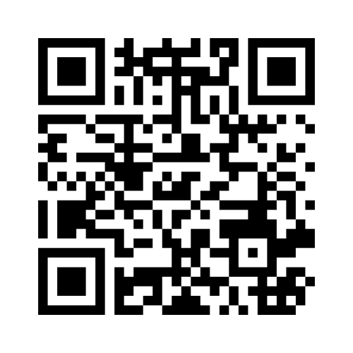
Ice breaker
https://www.menti.com/altt7yitgza5
The voting code 8179 0869

Slide 13
Activity: Taking a trauma informed approach
We would now like to run an activity with the group to look at the trauma informed approach and how as borough leads you can embed this into your practice and the wider adoption of the HEYL and HSL awards.
What we will do?
The group will be split into 3 groups to look at 2 of the following Trauma informed principals:
Safety
Trustworthiness
Choice
Collaboration
Empowerment
Cultural Consideration
There will be a facilitator in each group to capture responses on a Jamboard, for 15 mins
We will use the 10mins to share your responses with the wider group

Slide 14
Vicarious trauma and self-care
Vicarious trauma is defined as a negative reaction to the exposure of trauma, even if the person did not experience it first hand.
Vicarious trauma can change a person’s world view and sense of safety, trust and control of the world around them
It is important to consider how to keep staff safe and reduce potential for vicarious trauma by:
Encouraging staff to develop a strong sense of self-awareness – to know their stress limits
Improve access to peer or managerial support
Prioritise a work-life balance
Encourage staff to focus on what is within their power to change
Offer access to training and CPD
Offer opportunities to engage in reflective practice

Slide 15
Considering your self-care
https://www.menti.com/altt7yitgza5
The voting code 8179 0869

Slide 16
Additional resources

Slide 17
The Mayor’s call to #ChampionMentalHealth and wellbeing in London
We know that conversations around mental health are difficult. That’s why the Mayor of London launched a campaign in support of Londoners who #ChampionMentalHealth – in their families, places of work or their communities.
Londoners who sign up to #ChampionMentalHealth will receive the latest mental health training and resources to help them navigate tough conversations with compassion and confidence. It goes straight to their inboxes via a regular newsletter.
Get involved 👉 https://www.london.gov.uk/mental-health-wellbeing

Slide 18
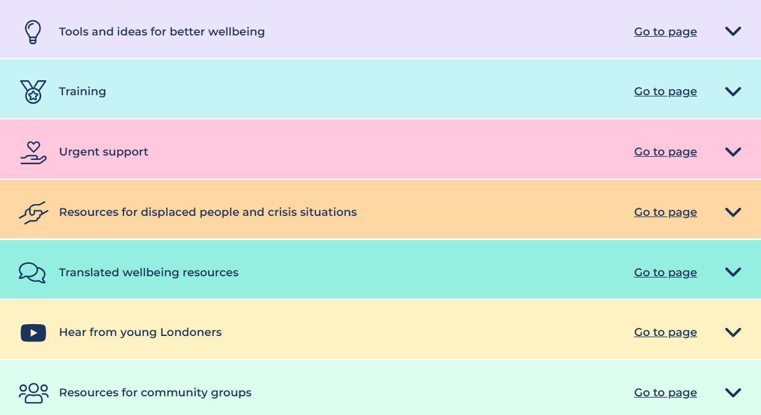
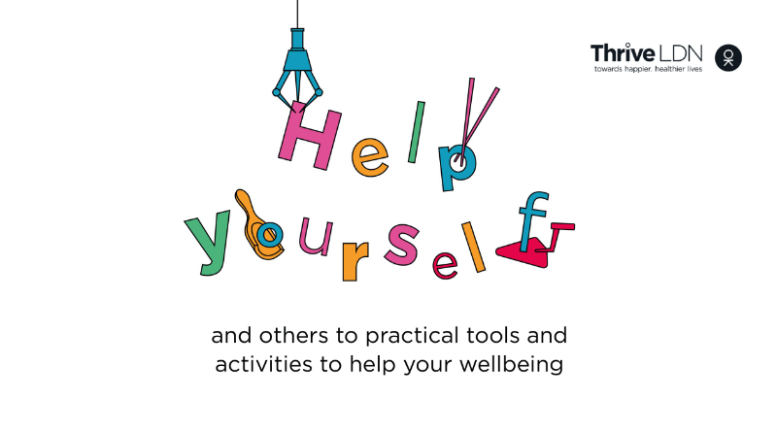
Help yourself and others
We have created a space on our website to bring together ideas, inspiration and resources to help build your resilience and improve wellbeing and to learn from community experiences.
Help Yourself and Others focuses on things that enable good wellbeing, alongside free wellbeing training opportunities. For those who need it, you're only one click away from more direct support, such as NHS talking therapies or urgent helplines.
Access the web page HERE

Slide 19
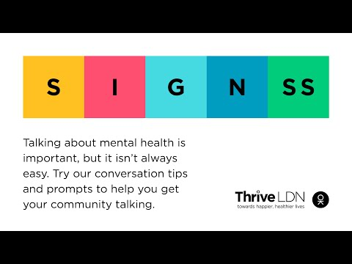
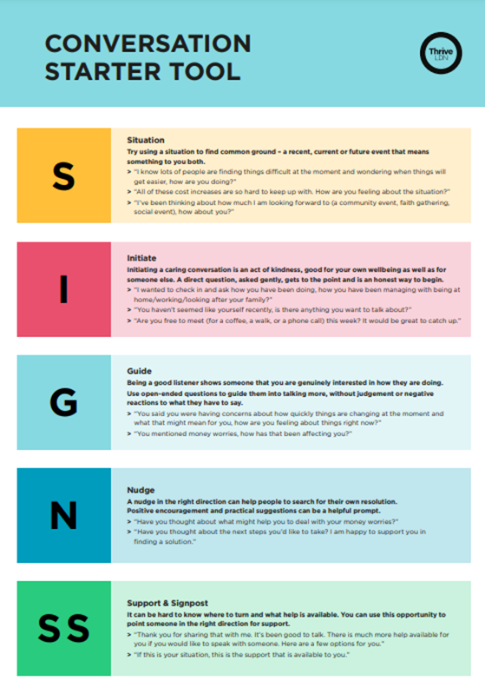
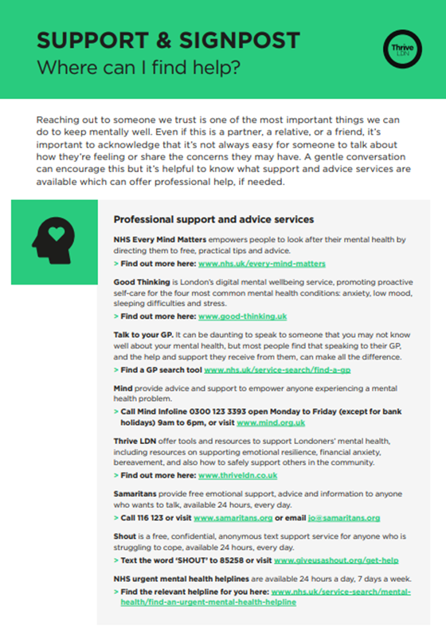
SIGNSS: Thrive LDN’s conversation starter
Talking about mental health… Access Thrive LDN’s conversation starter HERE

Slide 20
#ZeroSuicideLDN – Suicide Prevention Training
More than 10 people a week take their own life in London. If someone you worked with was in crisis, would you know what to say? Thrive LDN is leading a campaign to get Londoners to take the FREE online suicide prevention training. We’ve partnered with the Zero Suicide Alliance, who have created a training program to help people to be able to identify warning signs and to feel comfortable having conversations about suicide.
TAKE THE 20 MIN TRAINING HERE

Slide 21
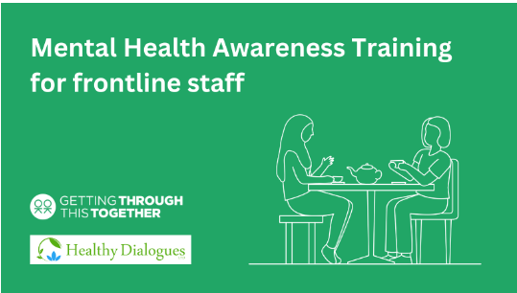
Mental Health Awareness Training for Frontline Staff
Thrive LDN has been working with Healthy Dialogues to offer a three pre-recorded training sessions about mental health and the impact of financial hardships.
There are three modules:
Module A: What is mental health and where to find support
Module B: Having conversations about mental health
Module C: How to support someone experiencing a mental health crisis
Access this training series HERE

Slide 22
Thank you
If you have any questions please get in touch.
Twitter | Instagram | Facebook | Tiktok | LinkedIn
thriveldn.co.uk

